Slide 1
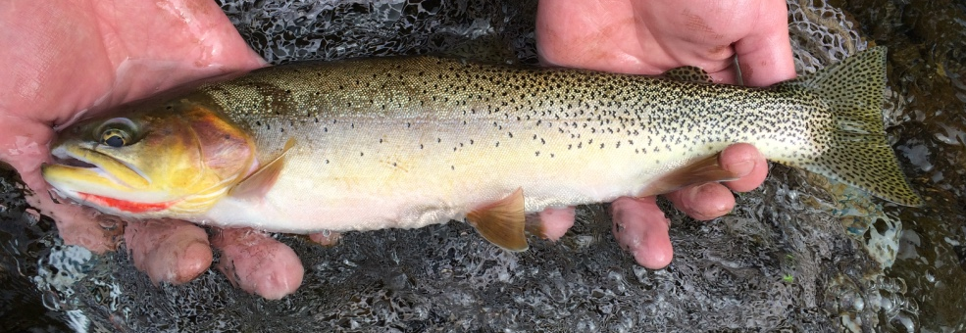
Headwater Stream Ecosystems
Zach Lessig

Slide 2

Why this study?
Stream metabolism incorporates information about all aerobic organisms and habitats.
Trout are the top predators in headwater streams and may indicate the functioning of lower trophic levels.

Slide 3
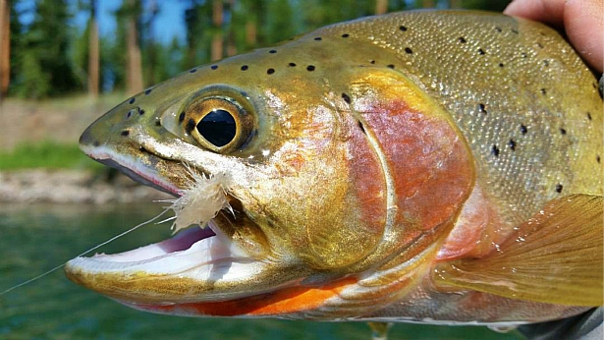
Why this study?
Objective:
Identify what headwater stream environmental variables best predict:
Ecosystem Respiration (ER)
Gross Primary Production (GPP)
Trout biomass.

Slide 4
Some terms…
Gross Primary Production (GPP) – this is the phototrophic synthesis of organic compounds using light and CO₂ which produces O₂.
Ecosystem Respiration (ER) – this is the release of CO₂ through metabolism by autotrophic and heterotrophic organisms which consumes O₂.
Trout Biomass – this is the estimated mass of all trout per stream reach.

Slide 5
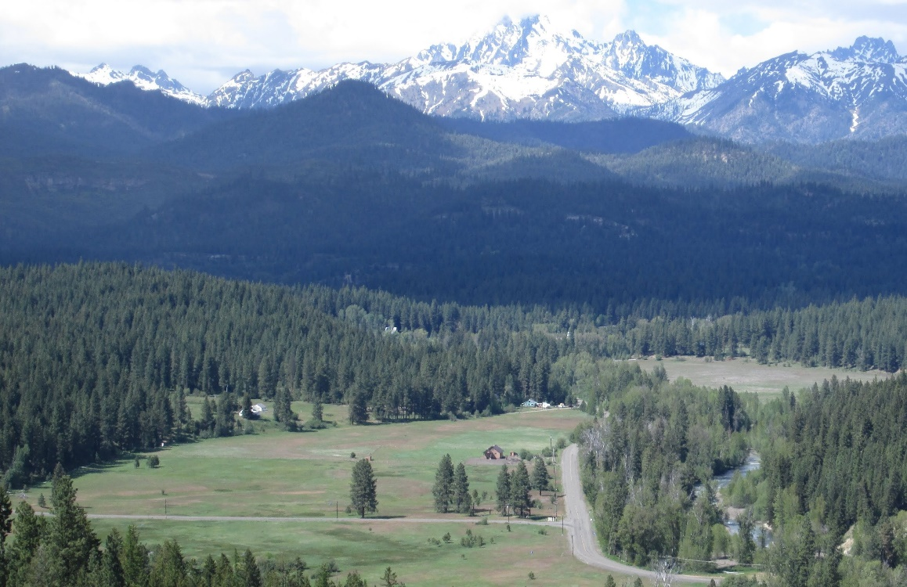
Basin
Swauk
Swauk
Iron
Blue
Hurley
Hovey
Teanaway
Miller
Jack
Standup
Taneum
First
Frost
Time of Sampling
Summer 2017
Fall 2017
Summer 2018

Slide 6
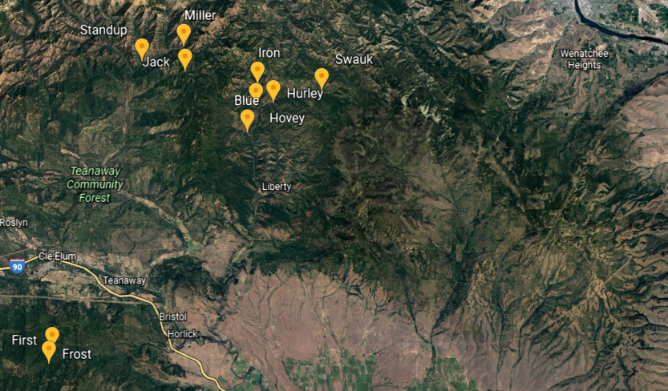
Teanaway drainage
Swauk drainage
Taneum drainage

Slide 7
Data Collected
Elevation (m)
Aspect (º)
Slope (%)
Bank Full (m)
Pebble Median (mm)
Wetted Width (m)
Depth (m)
Discharge (L/s)
Canopy (% open)
Carbon (C) (DOC mg C/L)
Nitrogen (N) (DIN mg N/L)
Phosphorus (P) (SRP mg P/L)
Photosynthetically Active Radiation (PAR) (µmol photons/m²/s)
Water Temperature (ºC)
Dissolved Oxygen (DO) (mg/L)
Cutthroat Biomass (g/m of stream)
Gross Primary Production (GPP) (g O₂/m²/d)
Ecosystem Respiration (ER) (g O₂/m²/d)

Slide 8
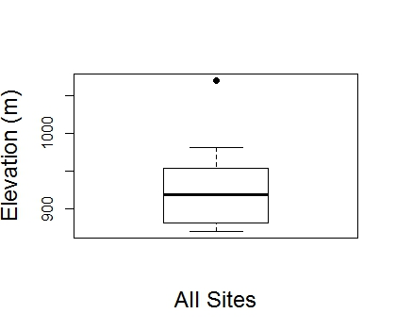
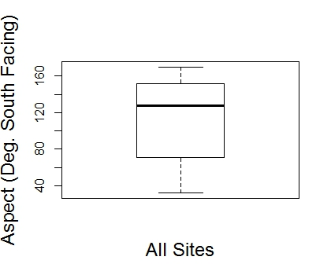
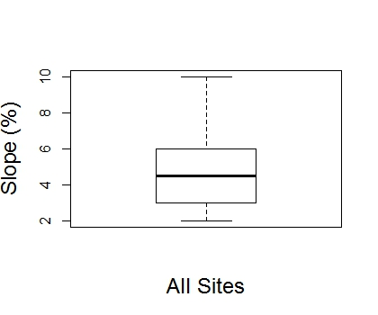
Geographic Site Variables

Slide 9
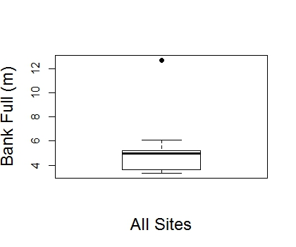
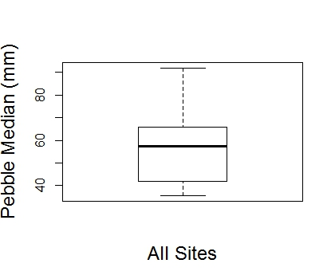
Hydrologic Site Variables

Slide 10
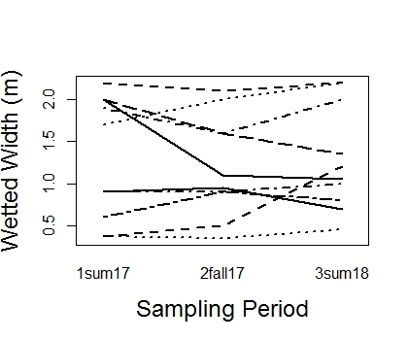
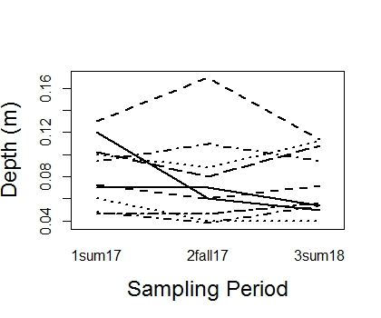
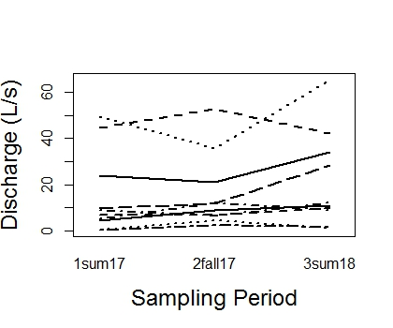
Hydrology Over Time
A
A
A
A
A
A
A
A
A
Width depth and discharge did not change over time.

Slide 11
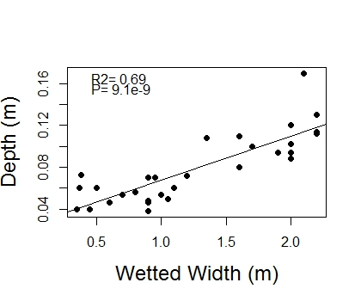
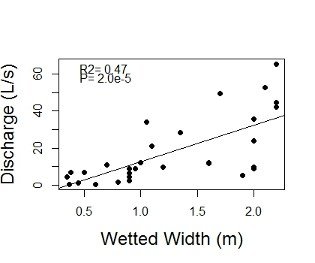
Hydrologic Relationships
Width, depth and discharge all increase together.

Slide 12
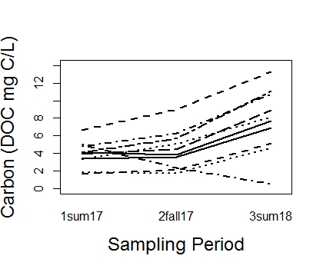
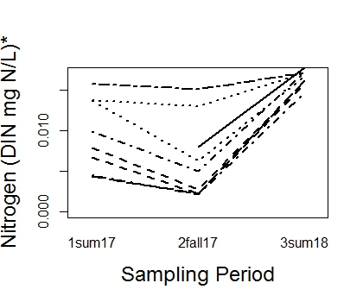
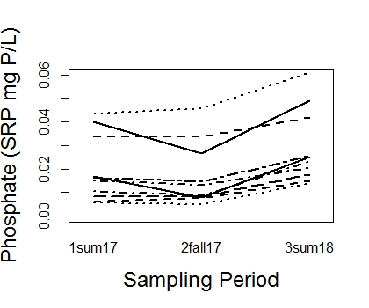
Nutrients Over Time
B
B
A
B
B
A
B
B
A
Nutrients do not differ at first 2 sampling periods and then go up for the third.

Slide 13
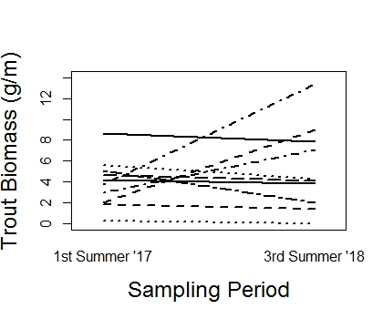
Trout Biomass
A
A
Trout biomass per stream length did not differ at the 2 different sampling periods.

Slide 14
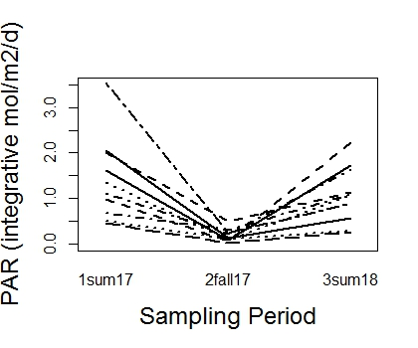
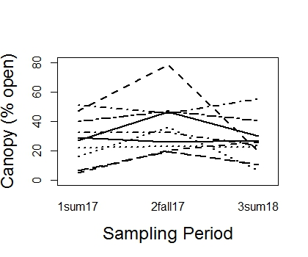
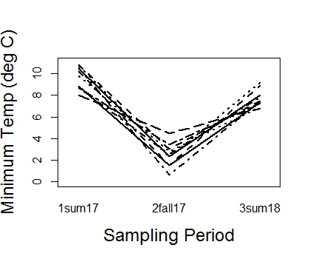
Light and Temp Over Time
A
B
A
A
A
A
A
C
B
Light and temperature follow expected seasonal patterns.
The temperature reflects an earlier sampling in the last summer than the first

Slide 15
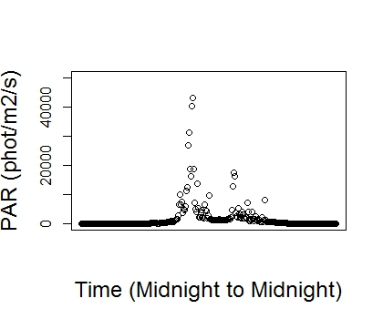
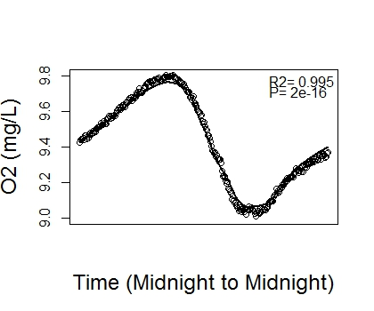
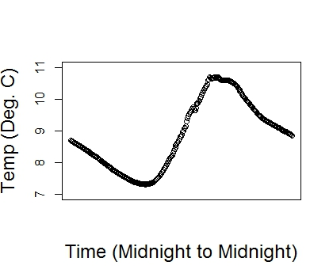
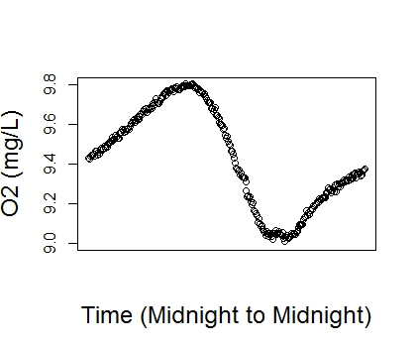
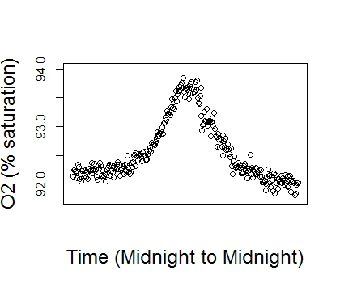
One station metabolism method using inverse modeling
Use this data to estimate:
Gas Exchange Constant (K600)
GPP
ER

Slide 16
Choosing a model to estimate metabolism
Use 1 model
Use 2 models
Run a model that estimates K600, GPP and ER
This method may risk an over-paramaterized model
This method produced less believable values
Derive K600 and use that for estimating GPP and ER
Run a “Nighttime Regression Model” that estimates K600
Derive K600 equation using “good” model output from the 1 model method
Derive K600 equation from literature data

Slide 17
Choosing a model to estimate metabolism
My Model for K600
Literature derived K600
Run models that estimate K600
Use “good” models to derive K600 where:
0<GPP
0>ER
0<K600
95<R2
Ln(K600)=1.6703*ln(Velocity)+3.2482
R2=0.27, P=0.07, N=26
Derive equation for K600 based on Hall (2018) to use in models
Ln(K600)=0.9557*ln(Slope)+3.0667
R2=0.68, P=0.01, N=8

Slide 18
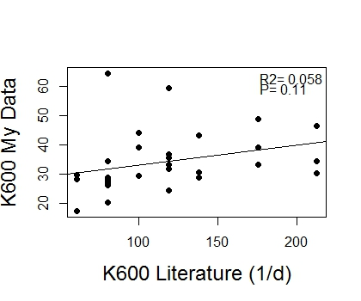
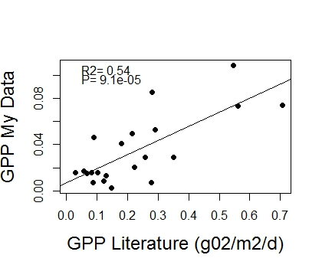
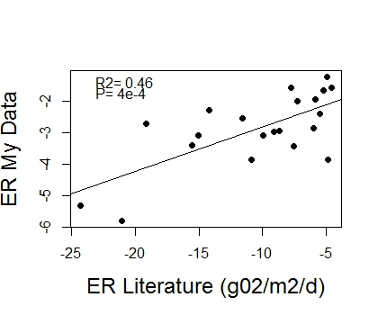
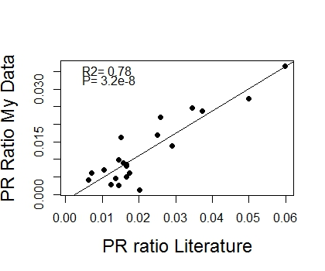
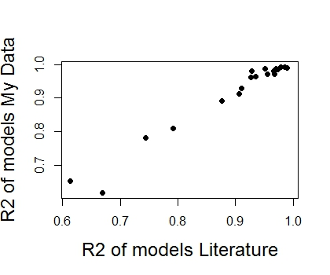
I chose the Literature derived equation.
4 of 30 models were dropped from further analysis.

Slide 19
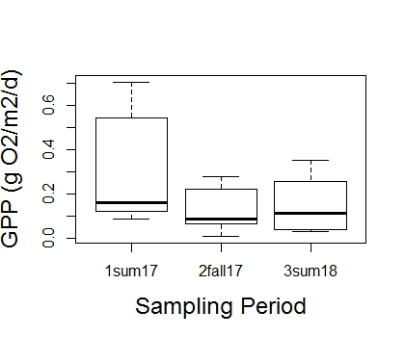
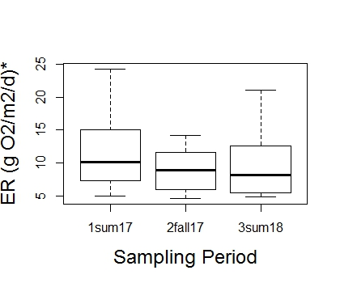
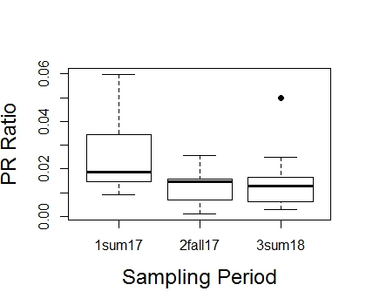
Metabolism Over Time
A
B
B
A
B
AB
A
A
A
Metabolism started off higher and then went down in magnitude for the following samplings.

Slide 20
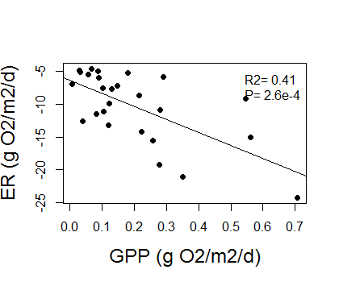
GPP and ER relationship
GPP and ER increase in magnitude together as expected.

Slide 21
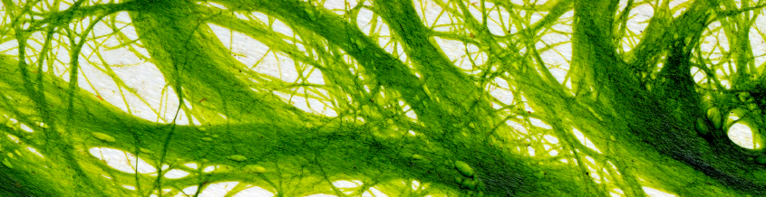
GPP model
Lme (Transformed GPP ~ Sampling Period + Depth)
log(1+GPP)^(1/2)
random = ~1|stream
varIdent(form = ~1|stream)

Slide 22
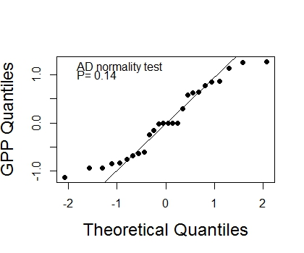
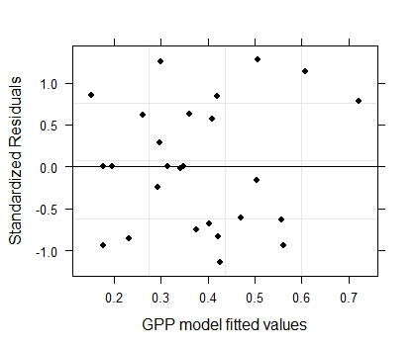
GPP Model Validation

Slide 23
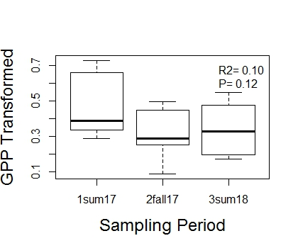
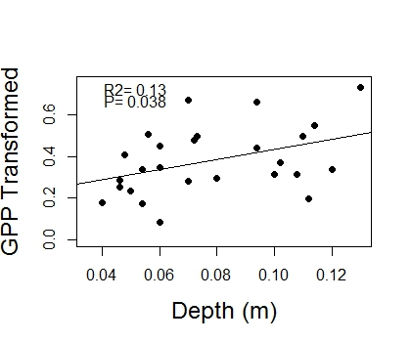
GPP Model Interpretation
GPP varies with sampling time and increases with depth.

Slide 24
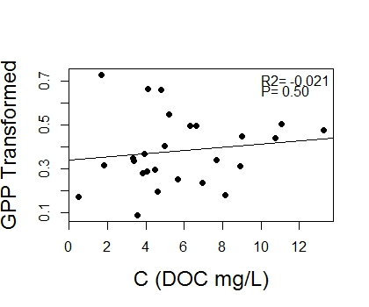
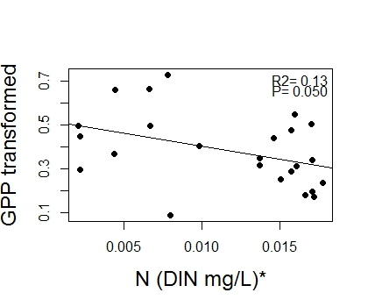
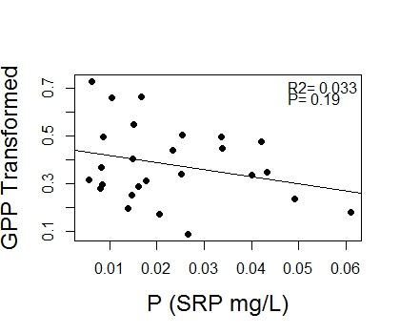
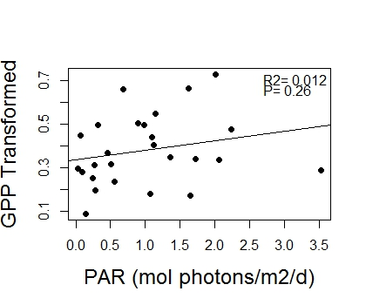
GPP Non-Model considerations
GPP appears unrelated to light and nutrients although weakly and negatively with DIN.

Slide 25
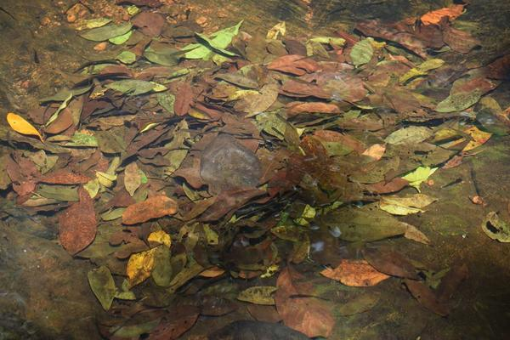
ER Model
Lme (Transformed ER ~ Depth + Slope)
log(1+|ER|)
random = ~1|stream
method=ML

Slide 26
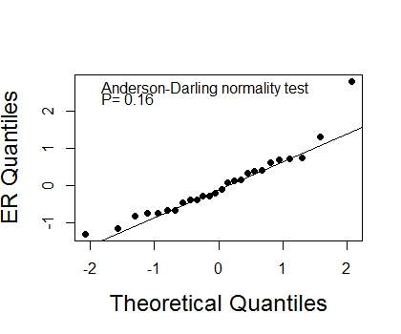
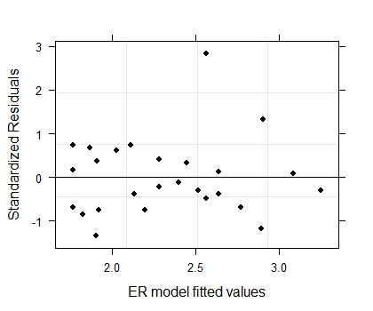
ER Model Validation
Hovey Summer ‘17

Slide 27
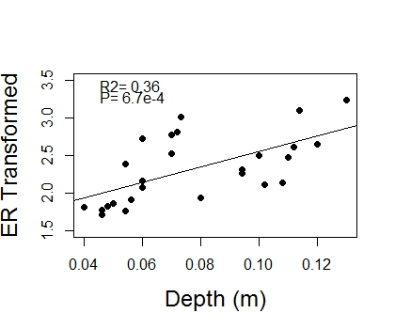
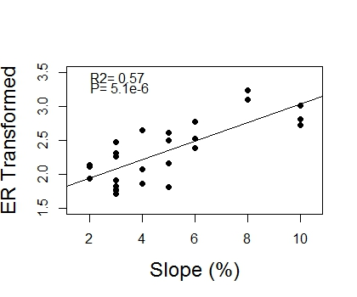
ER Model Interpretation
ER increases in magnitude with increasing depth and slope.

Slide 28
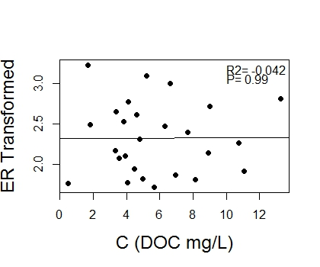


ER Non-Model Considerations
ER does not relate to nutrients.

Slide 29

Trout Biomass Model
gls(Transformed Trout Biomass ~ Basin + Width + Min Temp*Canopy Openness)
log(1+Trout Biomass)
varExp(form = ~fitted(.))

Slide 30


Trout Model Validation

Slide 31


Trout Biomass Model Interpretation
Trout biomass per stream length varies on basin and increases with increasing width.

Slide 32



Trout Biomass Model Interpretation
Low Temp
High Temp
Trout biomass increases with decreasing temperature and increasing canopy openness.

Slide 33




Trout Non-Model Considerations
Trout biomass appears unrelated to light and nutrients although possibly weakly and negatively with SRP.

Slide 34


Other Considerations…
Trout biomass does not relate to ER or GPP.

Slide 35


Other Considerations…
SRP and DOC increase in magnitude together?

Slide 36

Questions?

Slide 37


Slide 38


